Slide 1

Google Play Store Apps
Prepared By ➔ Ahmed Mohamed Mahrous & Ahmed Nassef

Slide 2

Today, 1.85 million different apps are available for users to download. Android users have even more from which to choose, with 2.56 million available through the Google Play Store. These apps have come to play a huge role in the way we live our lives today.

Slide 3

Table of Contents
Details about the dataset.
Basic Data Exploration(Understanding the Dataset).
Data processing & Cleaning.
Exploratory Data Analysis (EDA) and Business Analysis.
Check co-relation in data.
Model Building.
Model Performance Evaluation.

Slide 4

Details about the dataset.
This information is scraped from the Google Play Store. This app information would not be available without it.
The Play Store apps data has enormous potential to drive app-making businesses to success. Actionable insights can be drawn for developers to work on and capture the Android market!
Each app (row) has values for category, rating, size, and more.
Data Link ://www.kaggle.com/lava18/google-play-store-apps

Slide 5

Basic Data Exploration(Understanding the Dataset)
We will check the below things:
- Head of the dataset.
- The shape of the dataset.
- Datatypes for every column.
- Summary of the dataset.
Head of the dataset

Slide 6
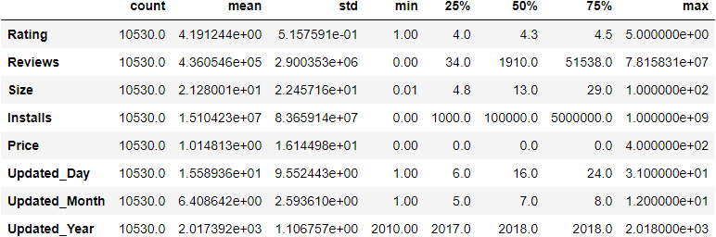
The data contains 10,841 rows and 14 columns.
The shape of the dataset
Datatypes for every column
Summary of the dataset
1- Category ➔ object
2- Rating ➔ float64
3- Reviews ➔ int32
4- Size ➔ object
5- Installs ➔ object
6- Type ➔ object
7- Price ➔ object
8- Content Rating ➔ object
9- Genres ➔ object
10- Last Updated ➔ object
11- Current Ver ➔ object
12- Android Ver ➔ object

Slide 7
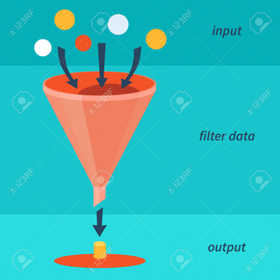
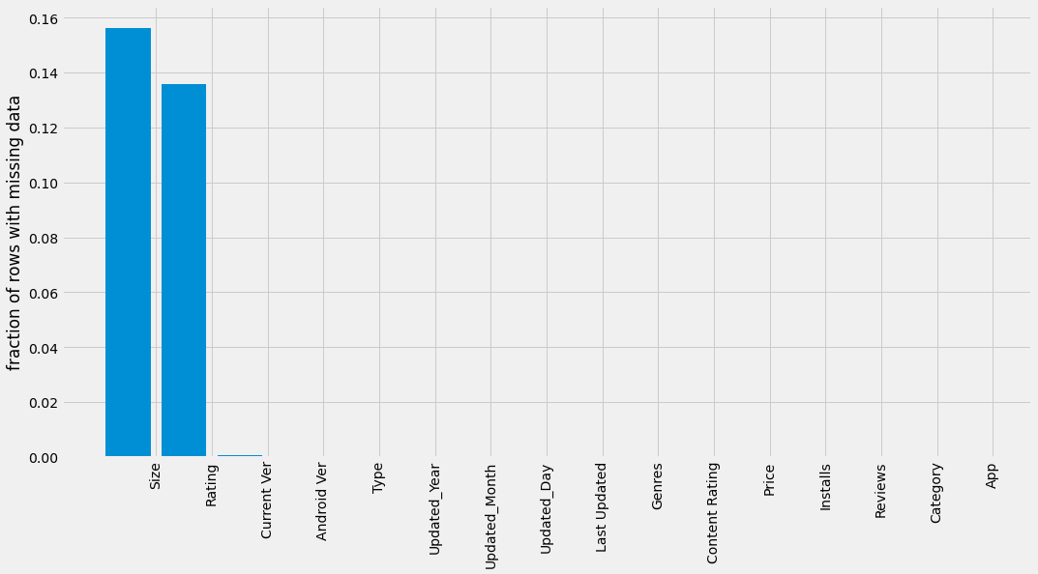
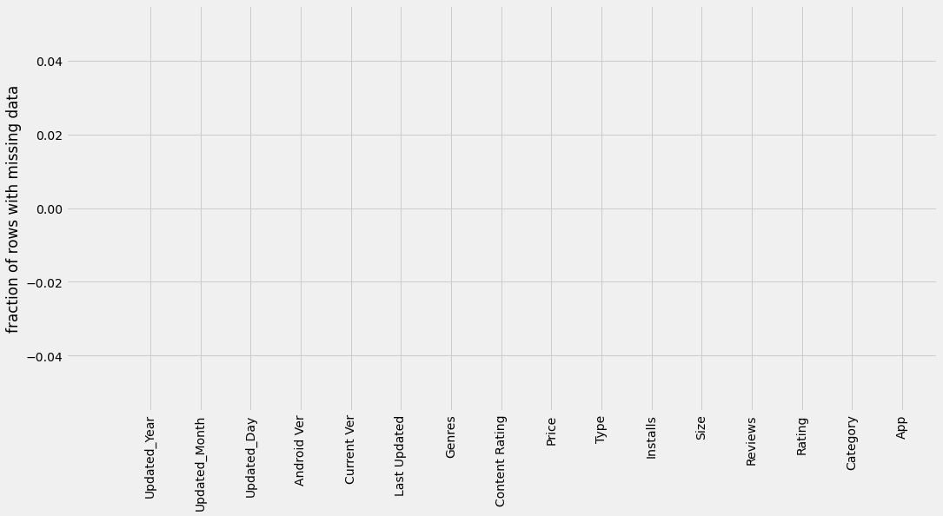
- Checking for null values
- Check Quilters
Data processing & Cleaning
Checking for null values
I Clean missing values using Random Value Imputation Because This the best way to maintain distribution For each feature.

Slide 8
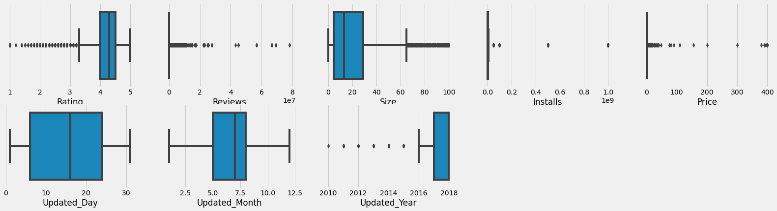
Check Quilters

Slide 9
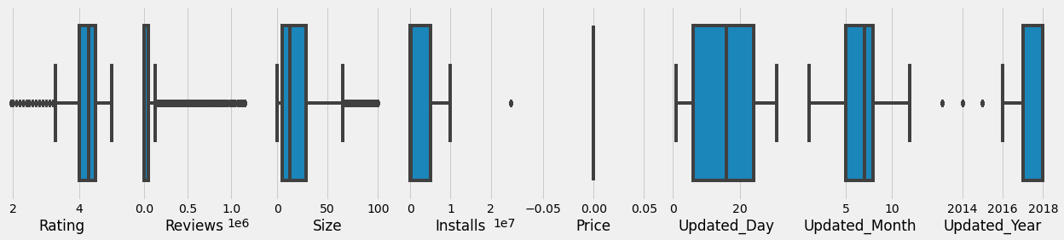
I removed the outliers by replacing the extreme outliers with the largest normal value in the data and the lowest outliers with the lowest normal value in the data.

Slide 10

What is EDA ?
is an approach for data analysis that employs a variety of technics (mostly graphical) to
* maximize insight into a dataset
* uncover underlying structure
* extract important variables
* answer questions
EDA Checklist :
1. What question(s) are you trying to solve ?
2. What kind of data do you have and how do you treat different types?
3. What do you get after visualize your data?
4. What is your observation
Exploratory Data Analysis (EDA) and Business Analysis

Slide 11
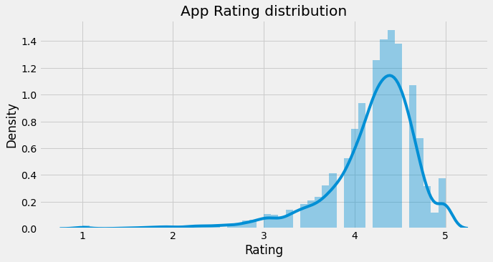
App Rating distribution
- The distribution of Rating size is left skewed.
- Average app Rating is: 4.18867261678694
- Median app Rating is: 4.3
- Mode app Rating is: 4.4

Slide 12
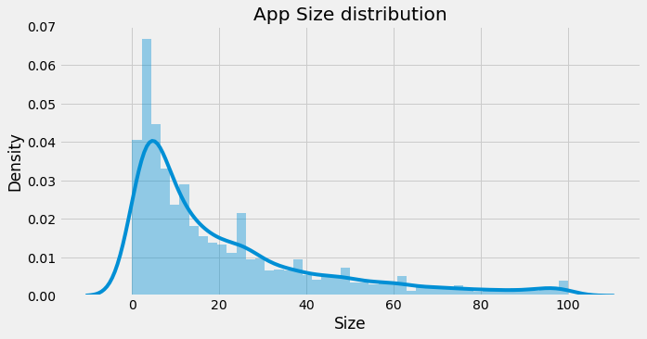
App Size distribution
- The distribution of app size is right skewed.
- Average app size is: 21.319796904671406
- Median app size is: 13.0
Mode app size is: 12.0

Slide 13
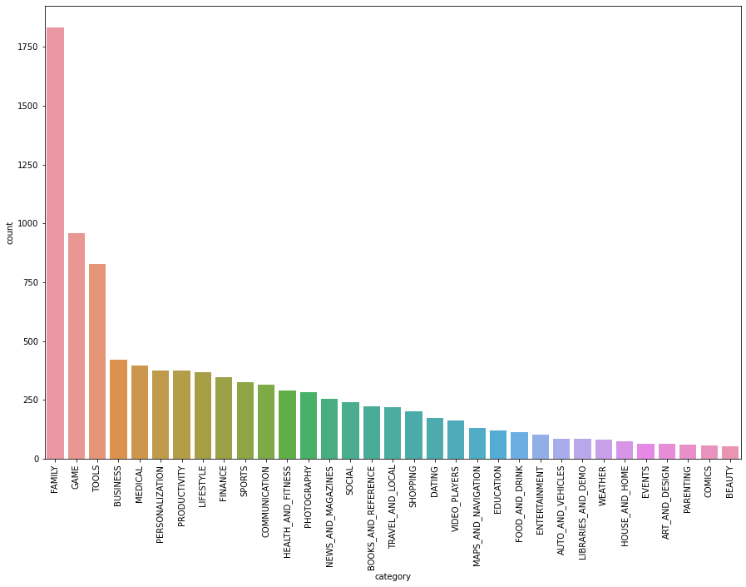

Most popular categories
Game and Family category are the most appearances for application in store

Slide 14
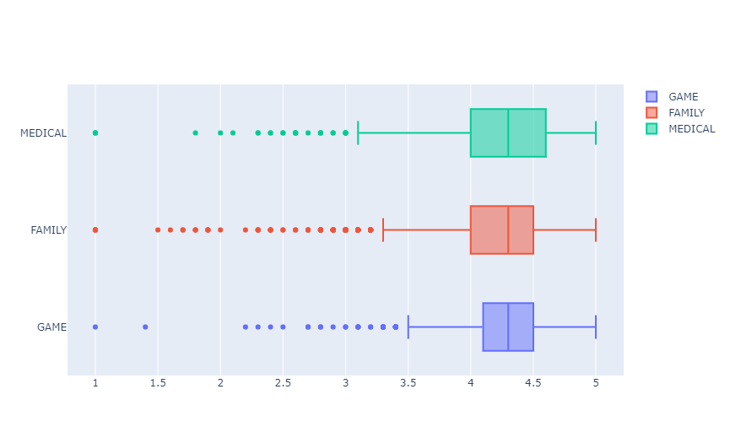
Game, Family and Medical Category (min,q1,median,q3,max value)

Slide 15
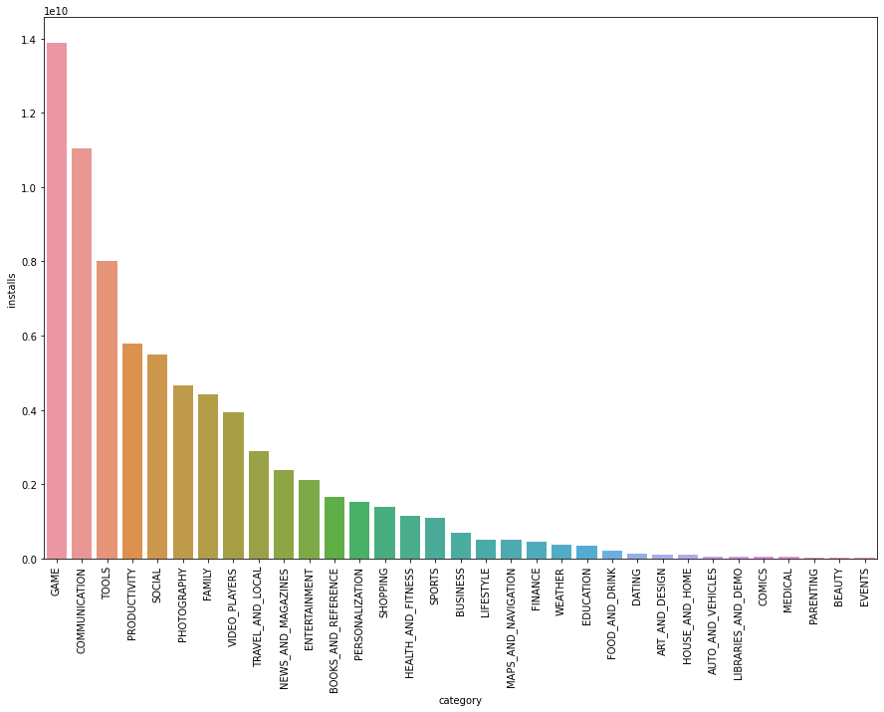
Most installed categories
It seems like people love to play and communicate

Slide 16
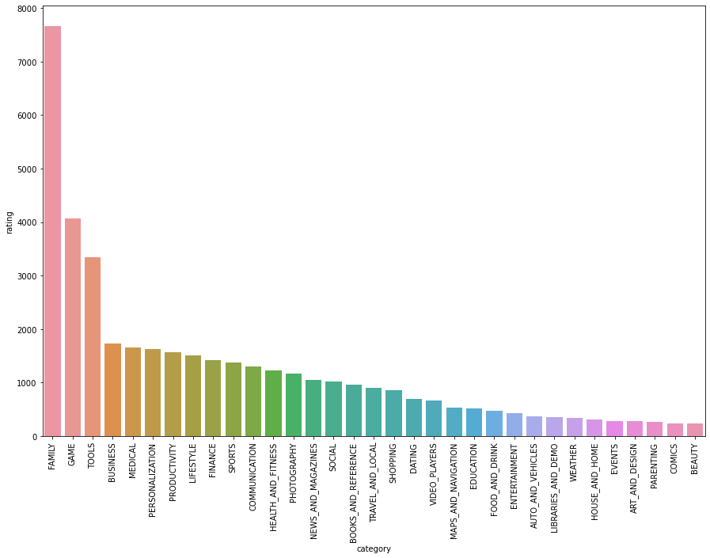
Highest Rated Categories

Slide 17
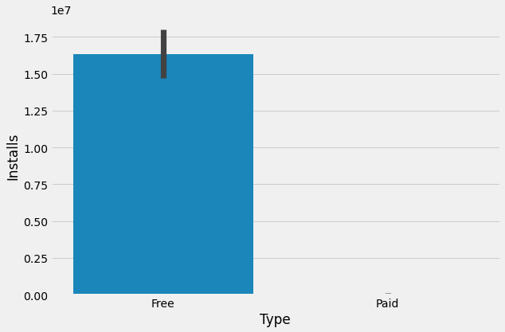
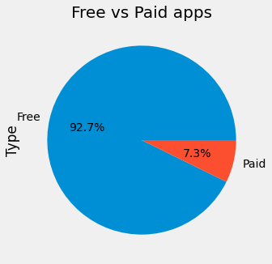
Does type of the apps affect number of installs
Free vs Paid apps
People tend to install free apps much more than install paid apps

Slide 18
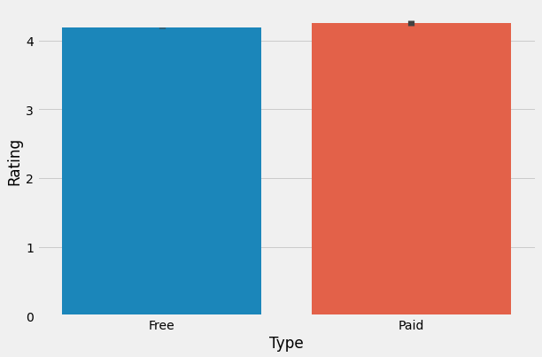
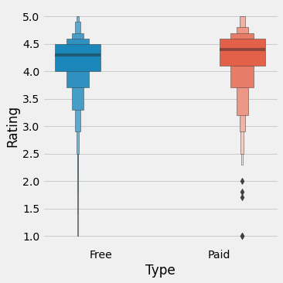
Does Type of the apps affect number of Rating

Slide 19
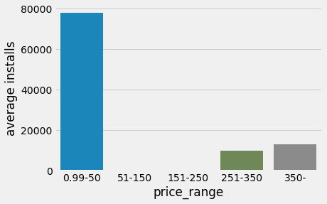
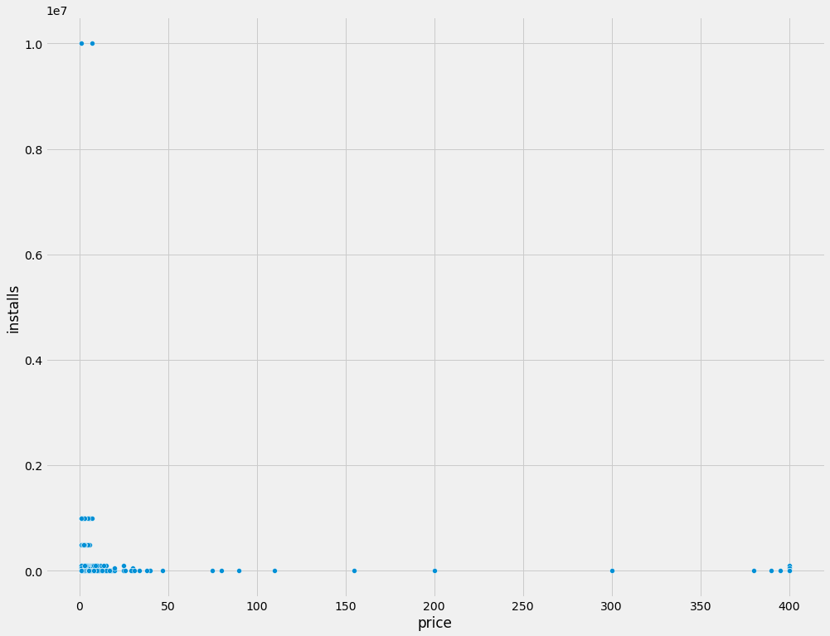
Does the price of paid apps affect the number of installs ?
In paid apps, people tend to install the cheap apps more than the expensive ones.
As we can see apps in the price range of (0.99$- 50$) are the most installed apps in paid type

Slide 20
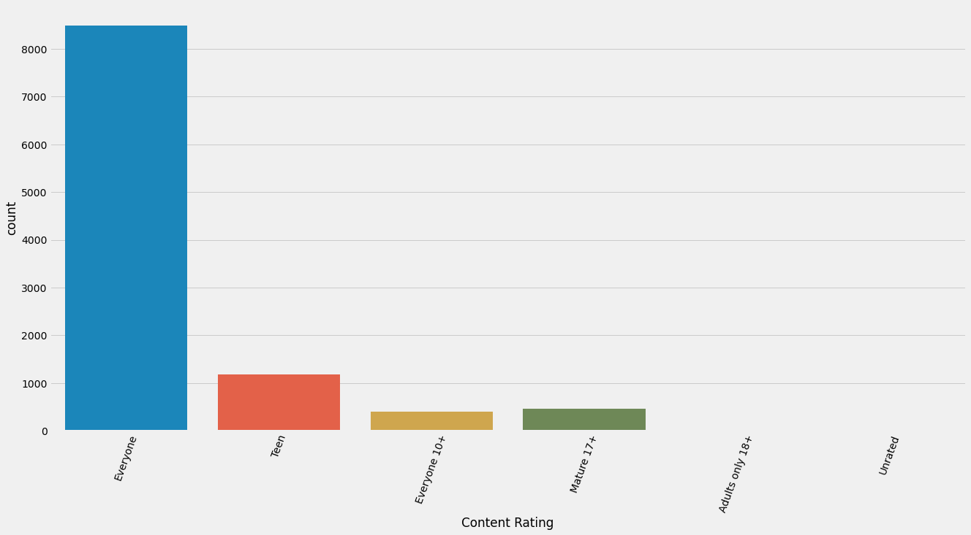
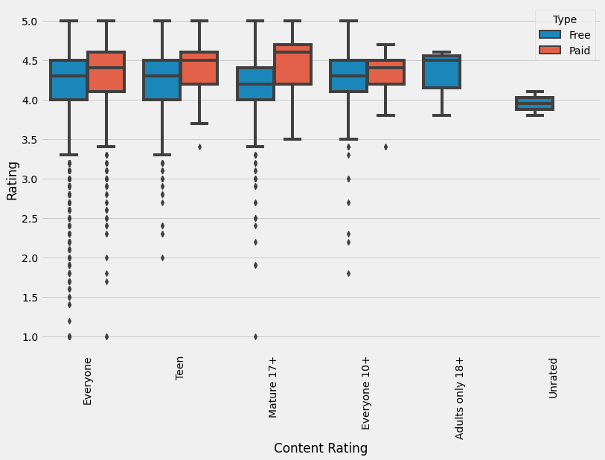
Count of each Category for Content Rating
Does Type of the apps affect number of Rating

Slide 21
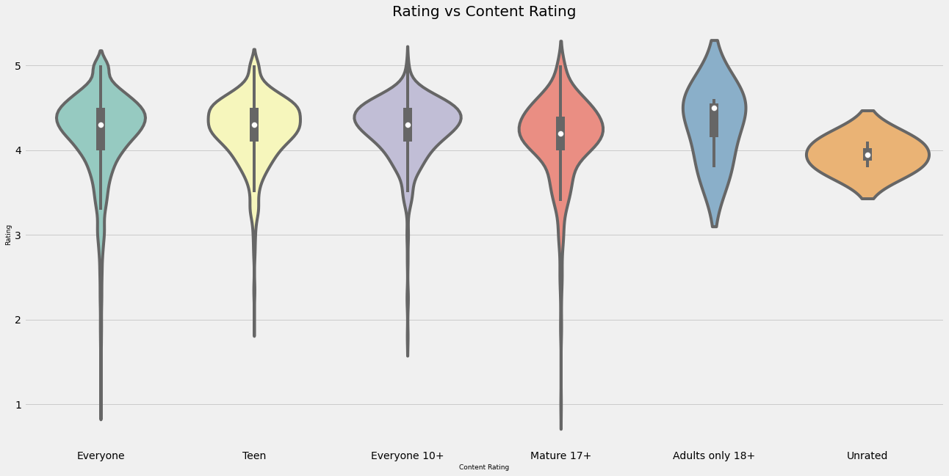

Slide 22
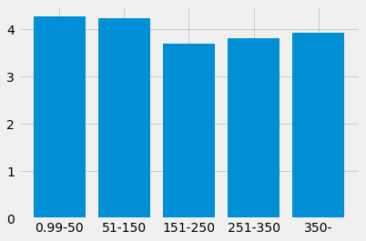
Does the price affect the rating?
The difference is slightly different between the groups, and there is no obvious relationship between them

Slide 23
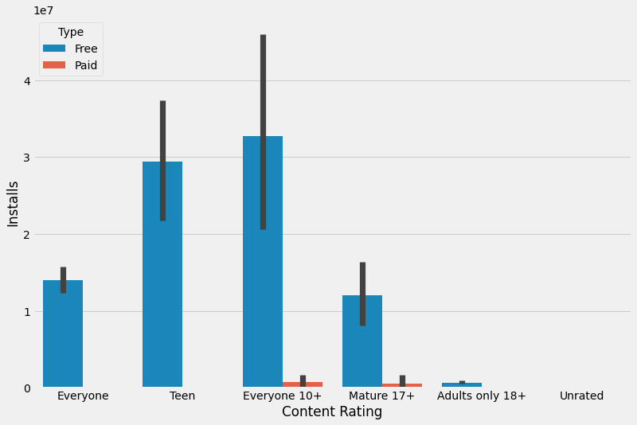
Content Rating & Installs

Slide 24
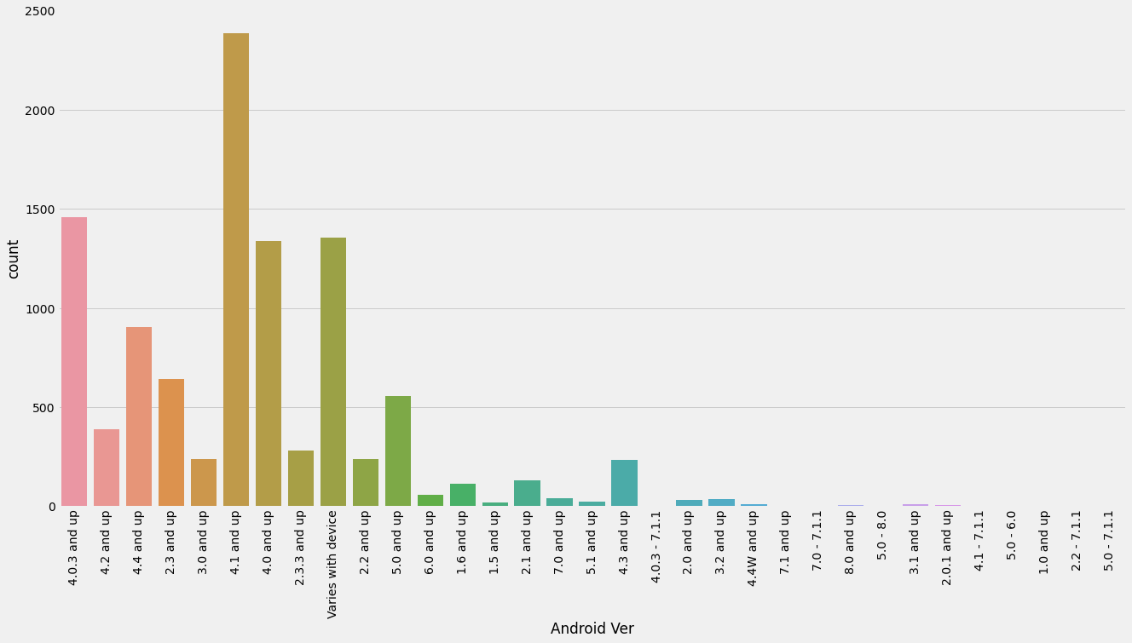
Count of each Version for Android Ver

Slide 25
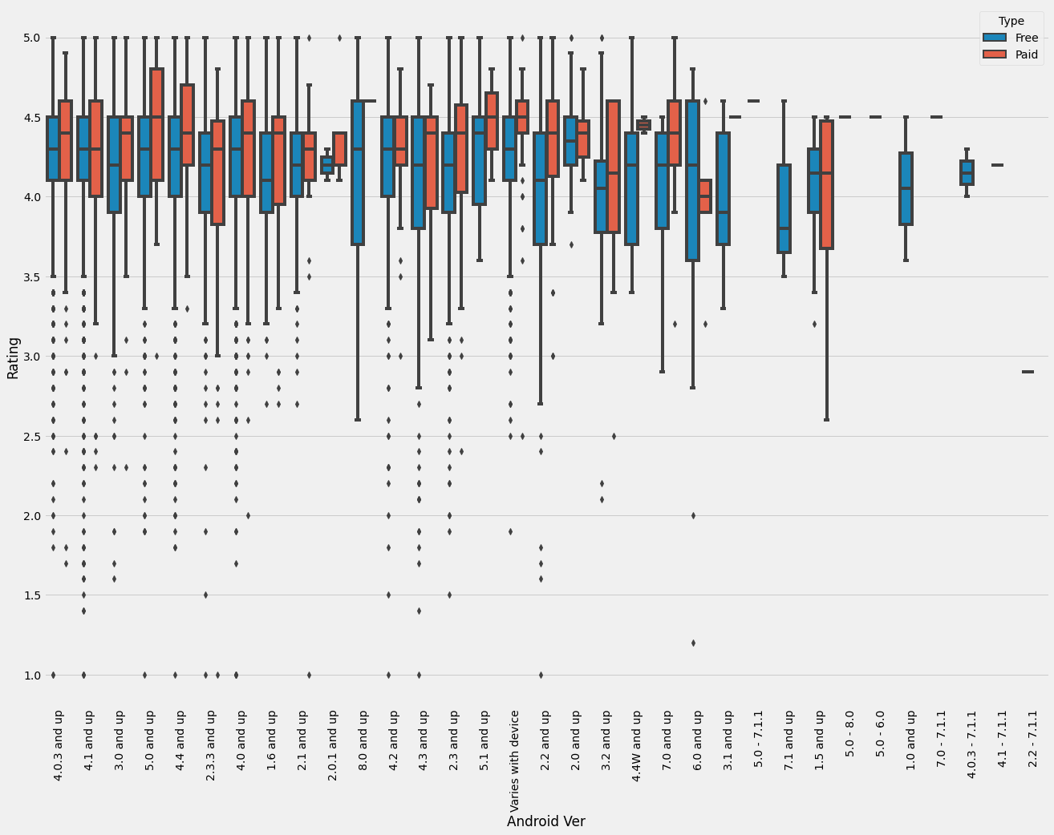
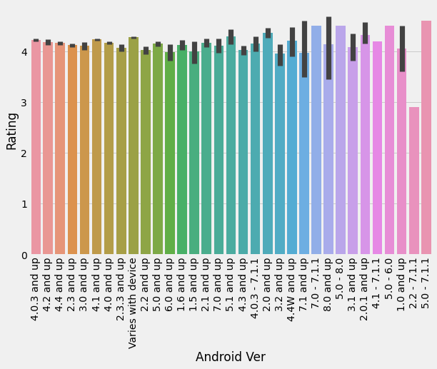
Rating & Android Ver

Slide 26
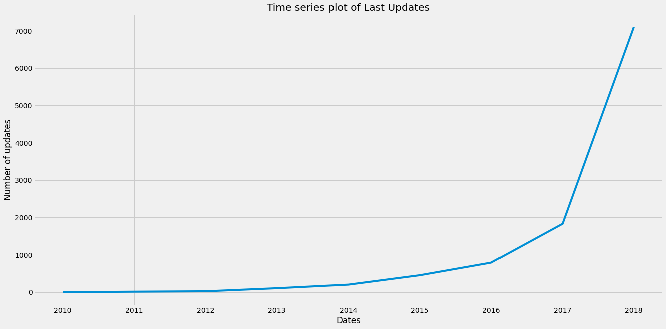
Time series plot of Last Updates

Slide 27
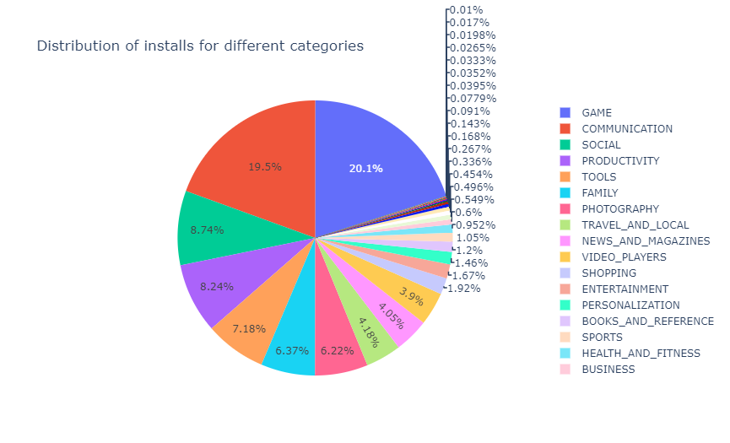
Distribution of installs for different categories
So from this we can see that the category with the highest number of installs is gaming which is followed by communications which includes the apps like Instagram,Facebook ,etc ....

Slide 28
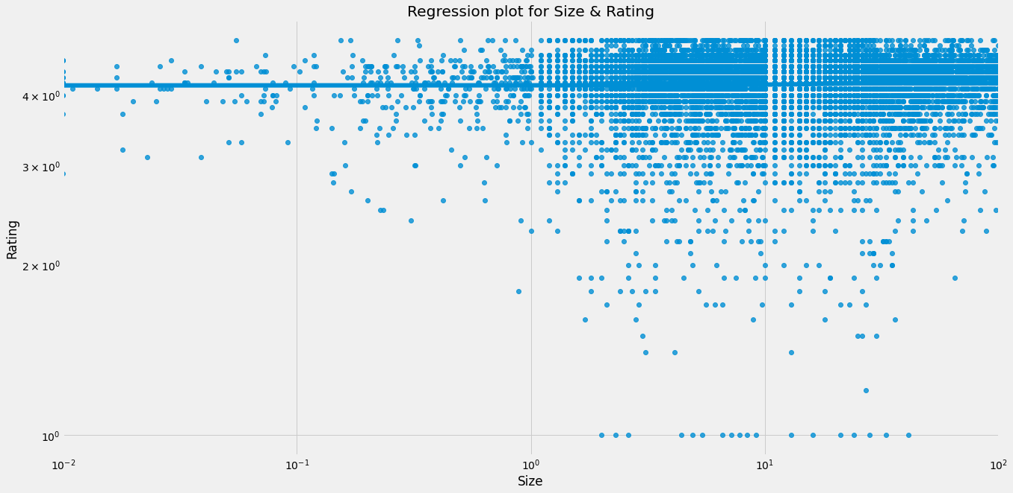
Relationship between Size & Rating
It is clear that there is no relationship between Size & Rating

Slide 29
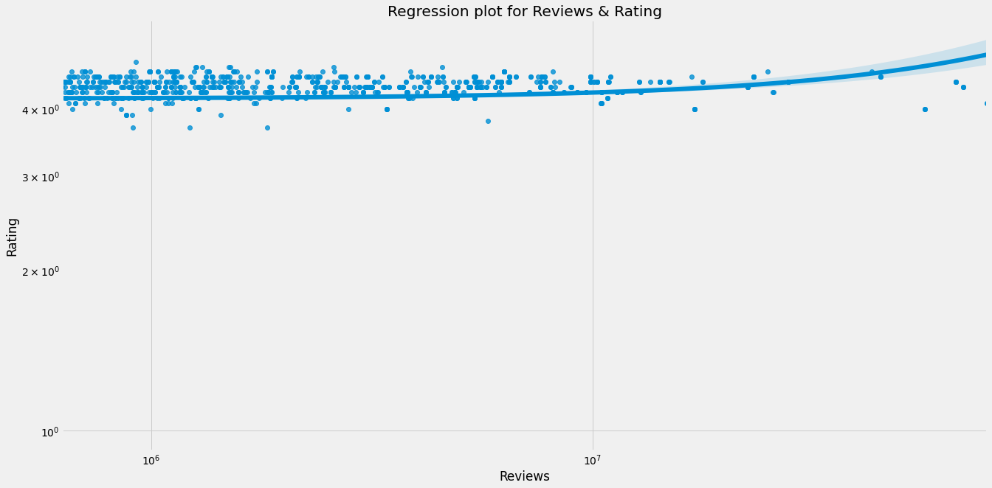
Relationship between Reviews & Rating
It is clear that there is no relationship between Reviews & Rating

Slide 30
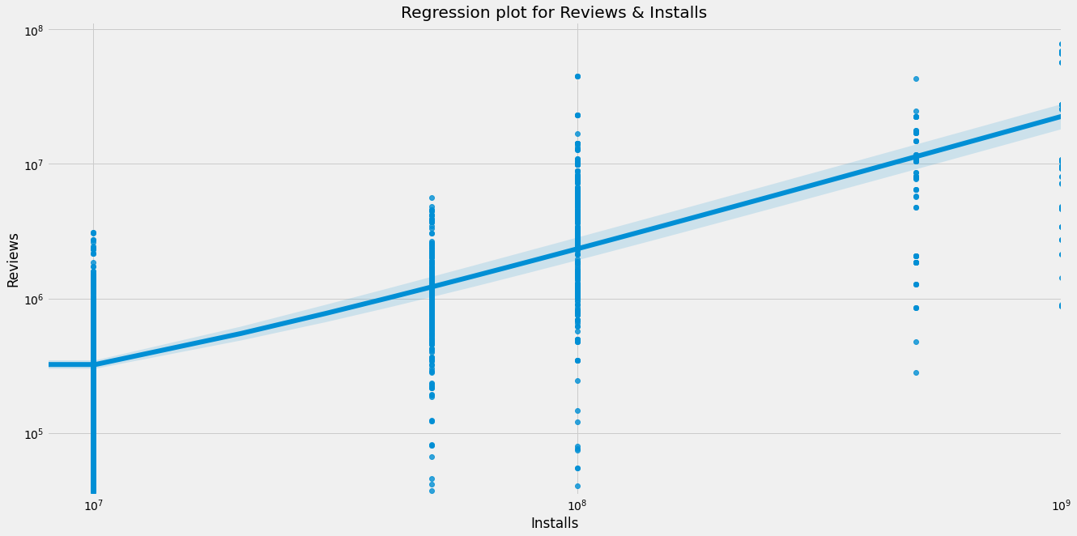
Relationship between Reviews & Installs
we can see that apps with more installs tends to have more reviews.

Slide 31
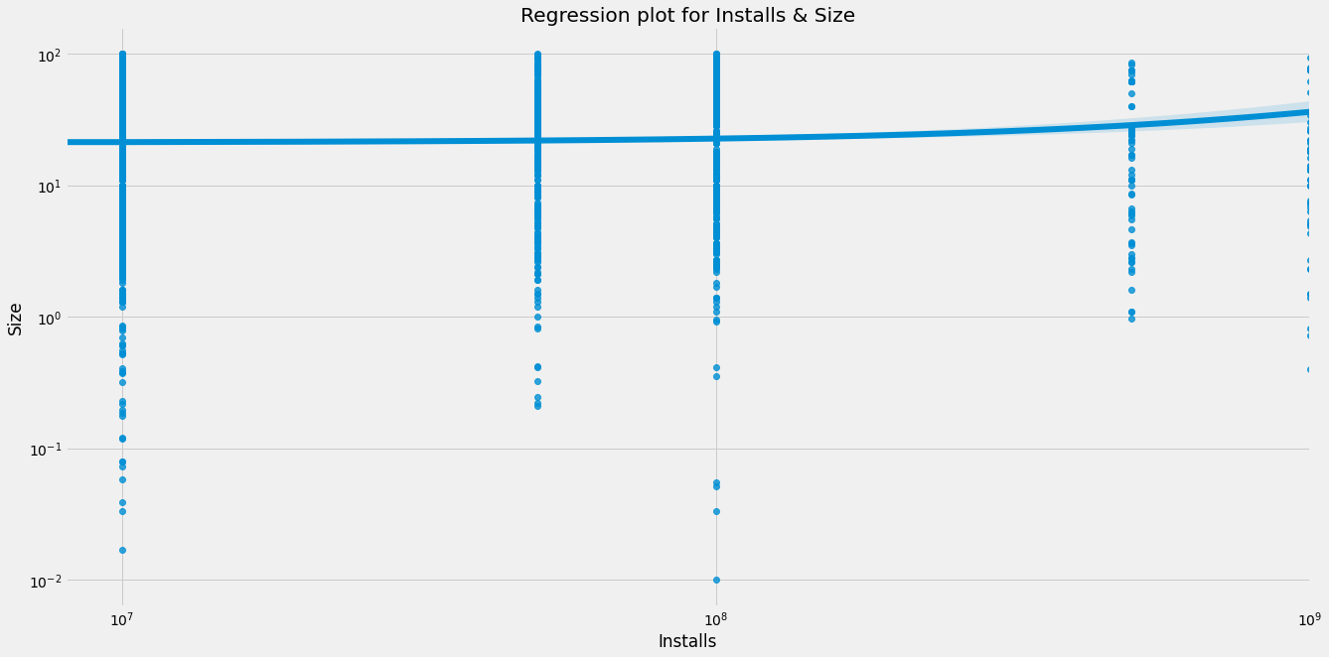
Relationship between Installs & Size
It is clear that there is no relationship between Size & Installs untill ``Installs = 10^8.5`` Then the value of the Size increases with an increase Installs.

Slide 32
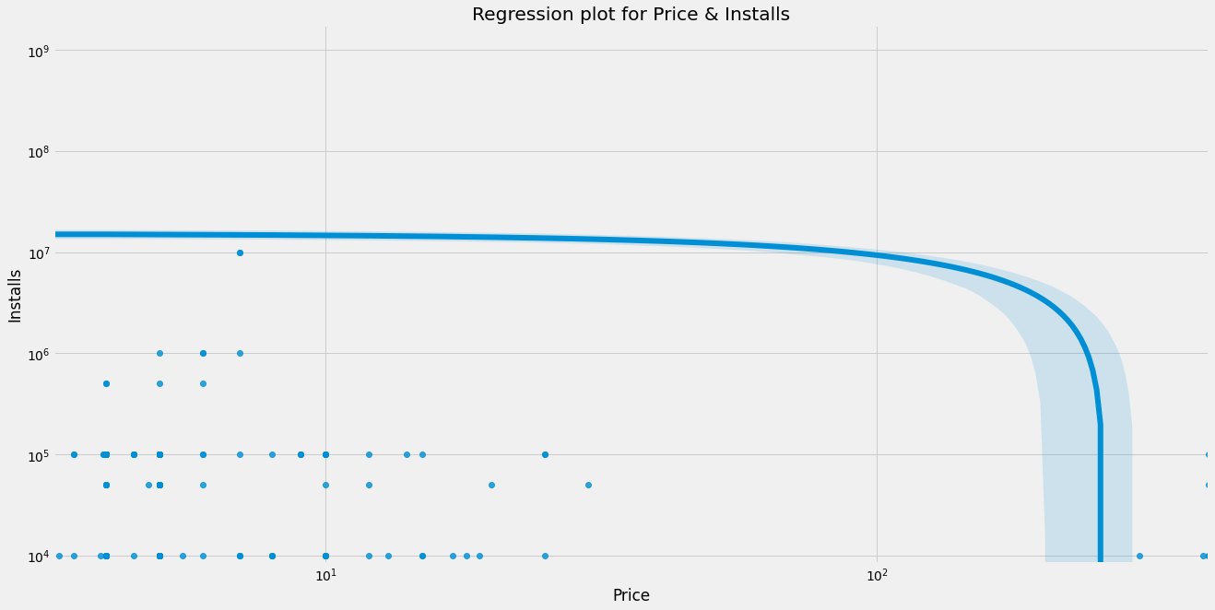
Relationship between Price & Installs
It is clear that there is no relationship between Price & Installs untill ``Price = 10^2`` Then the value of the Installs decreases with an increase Price.

Slide 33
What are the categories with, most number of reviews, highest rating, most revenue through installs, most number of installs?
- Maximum number of reviews is of : Facebook with a value of 78158306.
- Maximum price is of : I'm Rich - Trump Edition with a value of 400.0.
- Maximum Rating is of : Hojiboy Tojiboyev Life Hacks with a value of 5.0.
- Maximum number of installs is of : Google Play Books with a value of 1000000000.

Slide 34
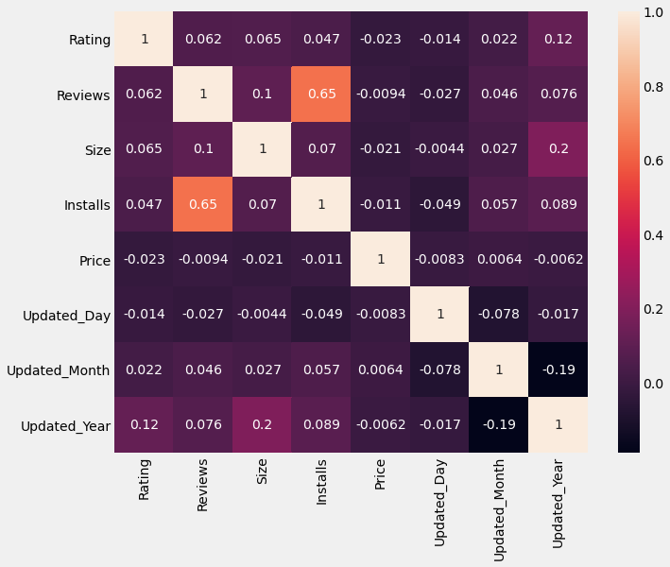
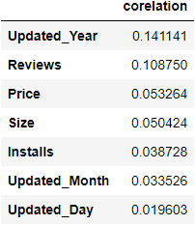
Check co-relation in data

Slide 35
I Separate Data into dependent & independent features
Dependent Features ➔ (Rating)
Independent Feature ➔ (Rating ,Reviews , Size, Installs ,Price , Updated_Day, Updated_Month, Updated_Year)
I Spilt data into for categories [ x_train ,x_test ,y_train ,y_test ]
I Created a Standard Scaler object to normalize the X train and test set feature data.
I Defined function For ML model.
I Used GradientBoostingRegressor Algorithm.
['
Models Building

Slide 36
Training score : 0.9989423757003361
Testing score : 1.0
r2 score: 0.9971736381798373
MAE: 0.0026302856219799424
MSE: 0.0007752703082578146
RMSE: 0.027843676270525315
Model Performance Evaluation

Slide 37


